Slide 1
WAGs
(Writing Accountability Groups)
Emily C. McGowan, MD PhD
Assistant Professor, Departments of Medicine and Pediatrics
Division of Allergy and Clinical Immunology

Slide 2
Disclaimer
I did not invent WAGs!
A lot of this talk is courtesy of Kim Skarupski at Johns Hopkins
Notes:
Who really pioneered WAGs and is an inspiration. I was fortunate enough to participate in some WAGs during my time at Hopkins and I can attest to the fact that they are a wonderful tool to increase productivity and also develop meaningful relationships with peers.
Associate dean for faculty development

Slide 3
Agenda
What is a WAG?
Why should we WAG?
How do we know that WAGs work?

Slide 4
Agenda
What is a WAG?
Why should we WAG?
How do we know that WAGs work?

Slide 5
What is a WAG?
A WAG is a peer-facilitated, active writing group that meets once a week for 1 hour over a 10-week block
  15 minutes of updates and goal setting
  30 minutes of timed, communal writing
  15 minutes of reporting and wrap-up
WAGs are focused on developing a process and habit of writing (no peer review)
Limited to 4-8 members and you MUST commit to attending at least 7 of the 10 weekly sessions.

Slide 6
Agenda
What is a WAG?
Why should we WAG?
How do we know that WAGs work?

Slide 7

Writing is hard!
“The truth is, writing is this: hard and boring and occasionally great but usually not.”
-- Amy Poehler
In academic medicine, scholarship is the coin of the realm, the currency of the trade . . .
So . . . writing is our job . . .
And, we need to do our job every day!

Slide 8

Rule of thumb for promotion
3 peer-reviewed manuscripts per year
  1 first-authored
  1 last/senior author
How do you make that happen??

Slide 9
Make Writing a HABIT!
21 / 90 Rule:
  21 days to establish a habit
  90 days to make it a permanent lifestyle change
Keys to habit change:
  Stack your habits
  Start small
  Do it every day
  Make it easy
  Reward yourself
Remember: Writing is your job!!
Notes:
We all do certain things every day—brush our teeth, drink a cup of coffee in the morning, watch the news at night, take the dog for a walk, exercise . . .
“However, I know you’re saying, yeah, this is all well and great, but there are so many things that are standing in my way . . . “

Slide 10
Which are YOUR barriers to writing?
I have trouble getting started
My perfectionism prevents me from finishing
I have too many clinical, teaching, or administrative commitments
I have too many personal / family commitments
I have difficulty with time management
I’m too busy writing grant applications
I have difficulty prioritizing
I don’t have adequate statistical or analytic support
I don’t have mentors to give me feedback and encourage me
I’m not very interested in my topic
I don’t know what to write about
English is not my first language
My writing skills are poor

Slide 11
Myths and Barriers to Writing
I can’t find time to write
I’m not ready to start writing
I need to be inspired to write
I can’t finish writing

Slide 12
Myths and Barriers to Writing
I can’t find time to write
I’m not ready to start writing
I need to be inspired to write
I can’t finish writing

Slide 13
Myth #1: I can’t find time to write
Myth: “I can’t find time to write.” “I have too many other responsibilities.” “I would write more if I had big blocks of time.”
Debunking: Life in academic medicine is crazy, and we have so many demands for our time (clinical responsibilities, families, teaching, research, etc). But . . . is there something that you still do every day? Exercise, watching a TV show, scrolling through Facebook, TikTok, etc?
Lesson: Don’t find time to write. Schedule time to write!
Notes:
You can’t find the time to write—it’s not going to magically poof out of the air and all of a sudden you’ll find, oh my goodness, I have 3 hours of uninterrupted writing time!

Slide 14
Franklin Covey’s Time Management
Notes:
People are going to come up and interrupt you during that time. Put up a sign, close your door, turn off your email. Make it a dedicated writing time.

Slide 15
Suggestions
Prolific writers make a schedule and stick to it.
Aim for a 30 minute block. If not 30, could you do 15?
The secret is the regularity, not the number of days/ hours.
Avoid binge writing
Defend your writing time.

Slide 16
Myths and Barriers to Writing
I can’t find time to write
I’m not ready to start writing
I need to be inspired to write
I can’t finish writing

Slide 17
Myth #2: I need to do more (…) first
Myth: “I need to do more analyses first.” “I need to read a few more articles.” Etc, etc, etc.
Debunking: Is anyone EVER ready to write?? There are so many moving pieces to academic writing: literature review, data acquisition, data analysis, interpretation, etc. By the time you’ve teed all that up, you’ve been scooped!
Lesson: Start writing when you have the idea. Do the actions that are necessary to complete a writing project during your scheduled writing time!

Slide 18
Suggestions
Start writing as soon as you have an idea for a project
Writing is not what you do AFTER you figure it out. Writing is HOW you figure it out!
Expand your definition of what constitutes “writing” and do it during your scheduled time
Consider using templates for manuscripts
Don’t try to be the expert in everything — delegate!
Notes:
I was just telling a colleague the other day, it’s amazing how much I figure out what my project is while I’m writing.

Slide 19
SMART Goals
Specific
Measurable
Achievable
Realistic
Time-Constrained
Instead of: “I’m going to write that paper,”
Think: “I’m going to outline the methods section and write two paragraphs of the Introduction.” Or, “I’m going to copy the odds ratios and 95% confidence intervals from the output to Table 3.”

Slide 20
Myths and Barriers to Writing
I can’t find time to write
I’m not ready to start writing
I need to be inspired to write
I can’t finish writing

Slide 21
Myth #3: The myth of the muse
Myth: ”I need to be in the mood to write.” ”I need to feel inspired.” “I do my best work under pressure.”
Debunking: Do you need inspiration to:
See your patients?
Give a lecture?
Send an email?
Take care of your kids?
Lesson: There is nothing magical about writing. It is just another skill that we can practice and learn. Also . . . writing is our job!

Slide 22
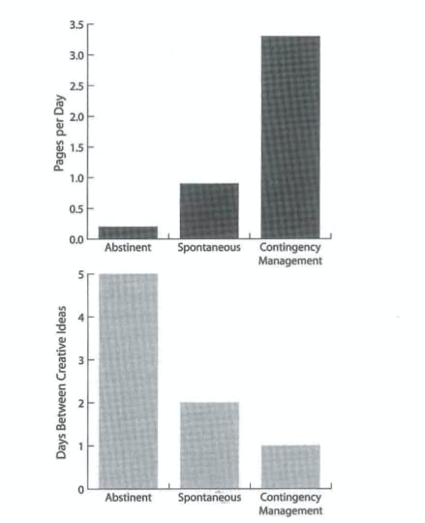
Waiting for Inspiration Doesn’t Work
College professors were randomly assigned to use different writing strategies
Measured:
  The number of pages written per day
  The number of creative ideas per day
Findings:
  Those who wrote every day wrote a lot
  Forcing people to write increased their creativity
Silvia PJ, “How to Write a Lot.” (Data from Boice 1990)
Notes:
Abstinent: Could only do emergency writing
Spontaneous: Scheduled 50 writing sessions but only wrote when inspired
Contingency: Scheduled 50 writing sessions and had to do them
Robert Boyce

Slide 23
What about writer’s block?
”Academic writers cannot get writer’s block . . . You’re not crafting a deep narrative or composing metaphors that expose mysteries of the human heart. The subtlety of your analysis of variance will not move people to tears . . . Novelists and poets are the landscape artists and portrait painters; academic writers are the people with big paint sprayers who repaint your basement.”
- Paul J. Silvia, “How to Write A Lot.”

Slide 24
Suggestions
Practice writing and schedule it
Establish a routine
Start on time and stop on time
Have a daily writing agenda

Slide 25
Myths and Barriers to Writing
I can’t find time to write
I’m not ready to start writing
I need to be inspired to write
I can’t finish writing

Slide 26
Myth #4: I can’t finish writing
Myth: “The paper isn’t perfect.” ”I just need a few more samples, data points, analyses, etc.”
Debunking: Your manuscript will never be perfect. Even the best-written journal articles will need some re-writing.
Lesson: “Perfection is the enemy of good enough.” Or, “Perfectionism is paralyzing” (PJ Silvia)

Slide 27
Suggestions
Take an inventory of the papers you’re working on and identify those “problem children.”
Triage the papers that are closest to getting out the door
Recalibrate your level of effort (your time is precious, so don’t waste it on things that give little return)
Ration your time on certain tasks
Notes:
Kim gives a talk at Hopkins on perfectionism and time management by David Youssem.

Slide 28
Agenda
What is a WAG?
Why should we WAG?
How do we know that WAGs work?

Slide 29
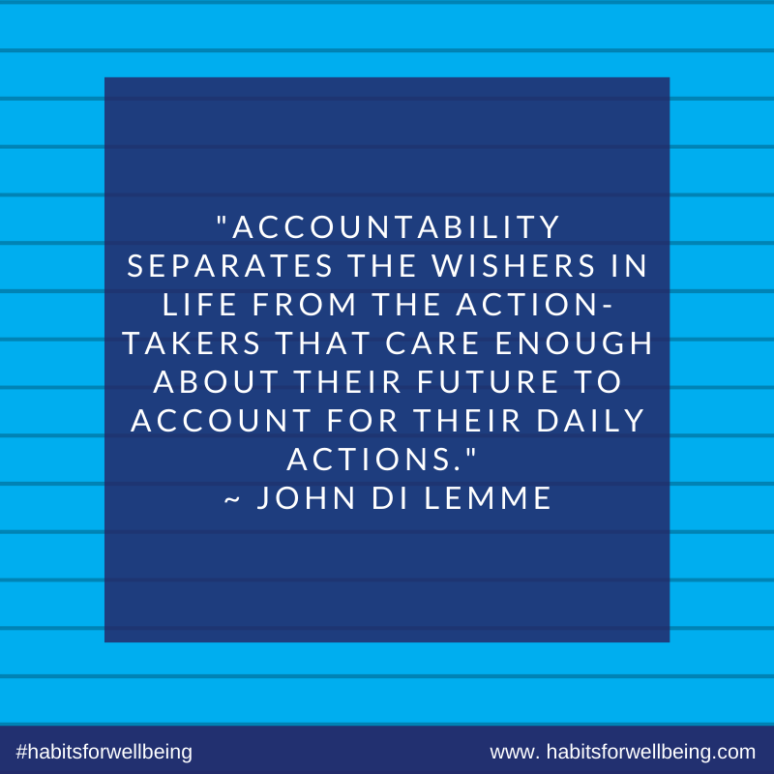
Why does a WAG work?
Being accountable to other people increases the likelihood that you will meet your writing goals.
Many of us will otherwise not make the time to write.
The WAG helps you become accountable and establish a writing HABIT.

Slide 30
Hopkins Data - Frequency
Data courtesy of Kim Skarupski

Slide 31
Hopkins Data - Duration
Data courtesy of Kim Skarupski

Slide 32
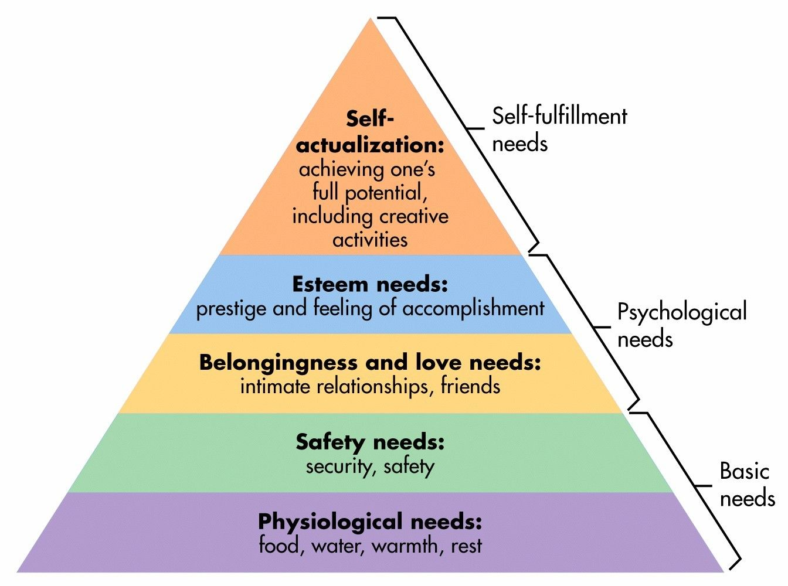
Outcomes of WAGs
Increased writing frequency
Shorter writing session duration
Greater perceived control of the writing process
Development of a social support network
Notes:
Maslow’s hierarchy of needs

Slide 33
Myths and Barriers Recap
Yes, you to time to write
Yes, you are ready to start writing
No, there is no writing muse
Yes, you can finish that paper!
Remember, writing is your job.
You need to do your job every day!

Slide 34
What is a WAG?
A WAG is a peer-facilitated, active writing group that meets once a week for 1 hour over a 10-week block
  15 minutes of updates and goal setting
  30 minutes of timed, communal writing
  15 minutes of reporting and wrap-up
WAGs are focused on developing a process and habit of writing (no peer review)
Limited to 4-8 members and you MUST commit to attending at least 7 of the 10 weekly sessions.

Slide 35
iTHRIV Support
Will help put people in contact with each other
Will provide a brief recap of WAGs at first meeting
Email us if you want to join or start a WAG!
Emily McGowan Jennifer Phillips ekc5v@virginia.edu jvp8a@virginia.edu

Slide 36
How to start a WAG
Join forces with at least 3 other people (4-8 people total)
Identify a meeting place and time that works for all for a 10-week period.
Meet weekly for 1 hour (15-30-15)
(and email us if you want to find a group!)

Slide 37

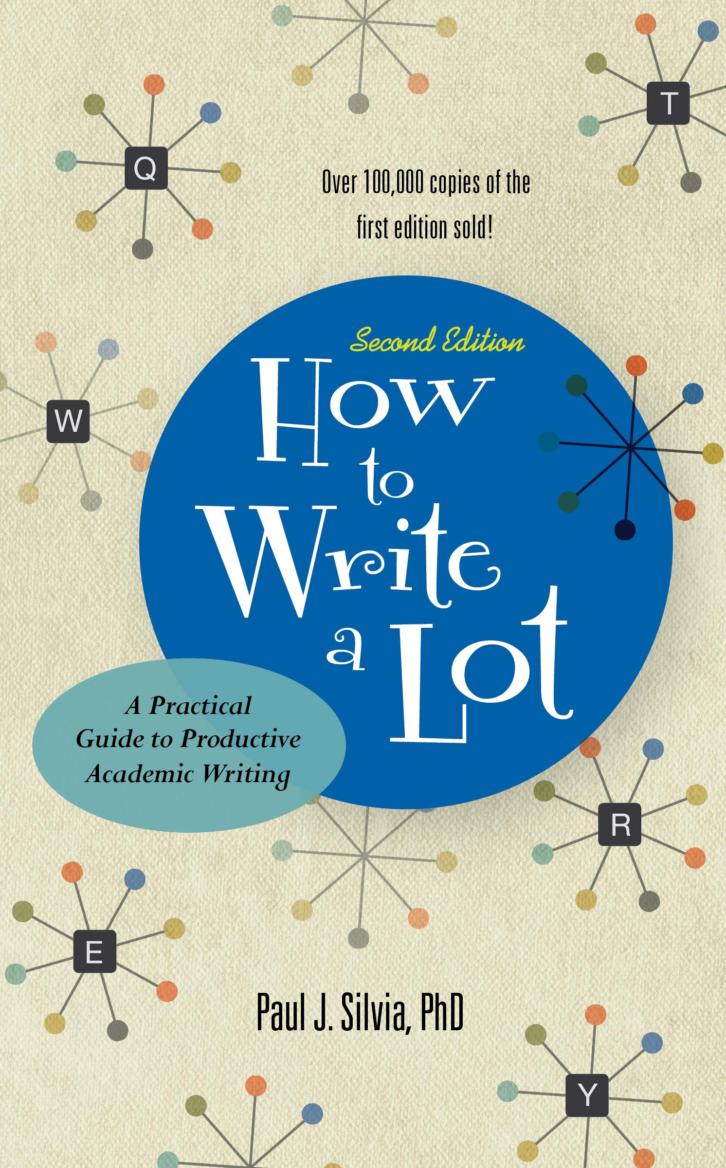
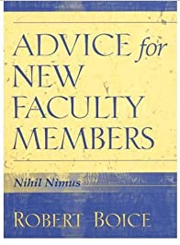
Other Resources

